Slide 1
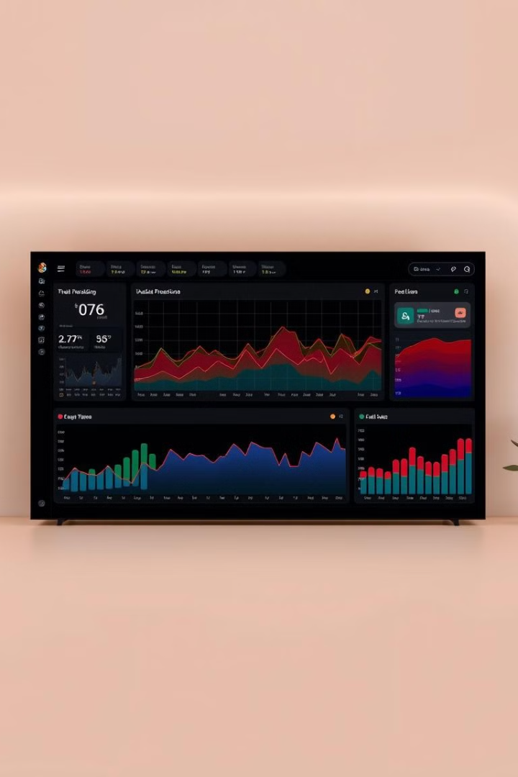
Streaming Platform Data Analysis
This presentation provides an overview of key data insights from our streaming platform:

Slide 2
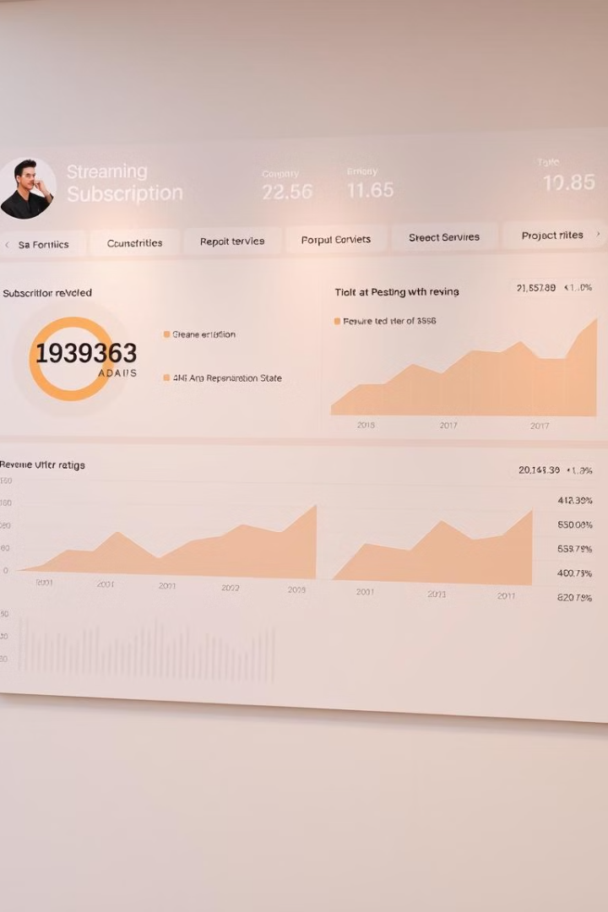
Subscription & Revenue Analysis
This presentation analyzes user distribution, revenue, engagement, demographics, and retention for our streaming service. We'll explore payment preferences, regional trends, and subscription patterns to provide actionable insights. T

Slide 3
User Distribution Across Price Tiers
Basic Plan
Premium Plan
Standard Plan
323 users (32.3%)
332 users (33.2%)
345 users (34.5%)
The Standard Plan is slightly more popular. User distribution is fairly balanced across all three tiers.

Slide 4
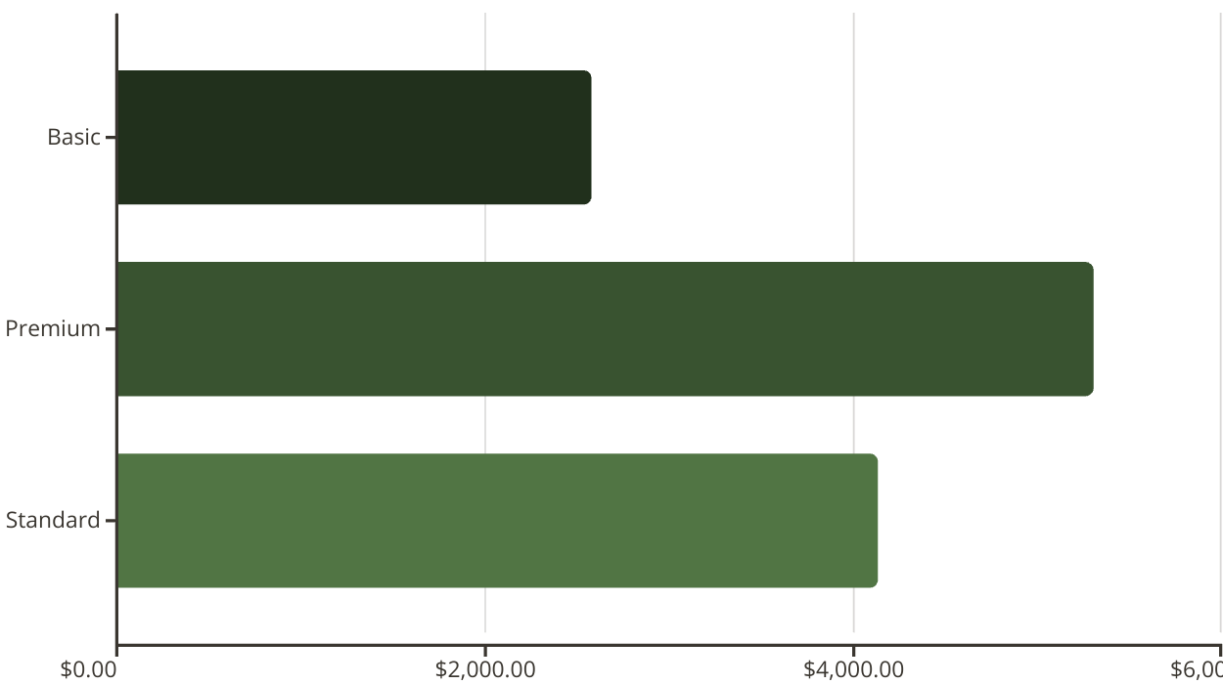
Revenue by Plan Type
The Premium Plan generates the most revenue, totaling $5,308.68 monthly. The Basic Plan yields the least revenue, at $2,580.77.
Out of Total 1000 Users , 345 users are having Standard Plan i.e 35% , 332 User are Premium Plan is having i.e 33% and 323 users are having basic plan i.e 32%, which is the lowest

Slide 5
MONTH WISE REVENUE
Out of total 25 Months, December 2023 Generated the highest amount of Revenue i.e $ 655.45
In 2022 the total Revenue collection was $ 223.82
In 2023 the total Revenue collection was $ 6126.89
In 2024 the total Revenue collection was $ 5675.29. Revenue Decline of (-) 7.33% on YOY basis.

Slide 6




User Engagement Metrics
Watch Hours
Movies Watched
Series Watched
254.52 hours per user show very high engagement levels.
515.89 movies watched on average.
99.74 series watched on average, much lower than movies.
Users prefer watching movies over series. There is very high overall engagement, with users watching an average of 254 hours per month.

Slide 7




Impact of Recommended Content
More Recommendations
Increased Engagement
Happier Users
More recommended content directly increases engagement. Recommendation engines can significantly increase engagement metrics.
Action Genre having highest recommendation(7812), Followed by Horror Genre(7726)
Documentary is having more engagement compared to other Genres.

Slide 8
Preferred Genres by Age Group
18-24
25-34
35-44
45-54 55+
Documentary
Horror
Horror
Romance Comedy
Overall: Most Preferred Is Horror Genre followed by Action

Slide 9
Preferred Device by Age Group
18-24
25-34
35-44
45-54 55+
TABLET
TABLET
TABLET
SMART TV SMART TV
Overall: Tablet Preferred by 215 Users, Smart TV and Smart Phone preferred by 209 users each

Slide 10

Peak Watch Time Trends
1
Morning
222 users
2
Afternoon
251 users
3
Evening
256 users
4
Late Night
271 users
Late Night is the most preferred watch time. Morning is the least preferred.

Slide 11

Active Users by Country
Australia
140
Canada
139
France
151
Germany
146
India
116
UK
150
USA
158
The USA has the highest number of active users (158). India has the fewest active users (116). Data for inactive users is not available.

Slide 12
Loyalty Points by Country
Australia
20469
Canada
9490
France
31094
Germany
17073
India
9462
UK
15879
USA
45349

Slide 13
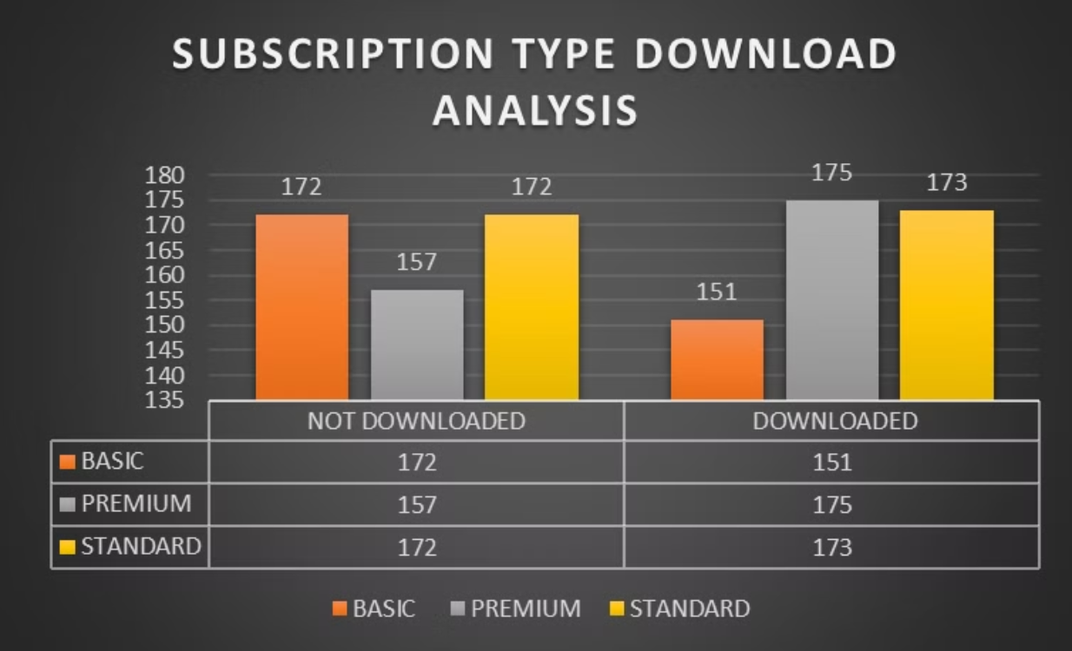
Premium users are Downloading Content more than compared to Standard and Basic Users

Slide 14
Payment Preferences by Region
Australia
Canada
France
Germany
Credit: 16%
Credit: 24%
Credit: 26%
Credit: 21%
Crypto: 31%
Crypto: 19%
Crypto: 27%
Crypto: 24%
Debit: 27%
Debit: 26%
Debit: 21%
Debit: 29%
Paypal:26%
Paypal:30%
Paypal:26%
Paypal:25%

Slide 15
Payment Preferences by Region
India
UK
USA
TOTAL
Credit: 22%
Credit: 22%
Credit: 28%
Credit: 23%
Crypto: 25%
Crypto: 25%
Crypto: 25%
Crypto: 25%
Debit: 34%
Debit: 21%
Debit: 21%
Debit: 25%
Paypal:20%
Paypal:32%
Paypal:32%
Paypal:27%
Paypal is widely used . Debit and Crypto have a balanced distribution.

Slide 16
Subscription Trends by Country Analysis 🌍📊
Australia: 140 subscribers(Mostly Preferring Premium Subscription)
Canada: 139 subscribers(Mostly Preferring Premium Subscription)
France: 151 subscribers(Mostly Preferring Basic Subscription)
Germany: 146 subscribers(Mostly Preferring Standard Subscription)
India: 116 subscribers(Mostly Preferring Standard Subscription)
UK: 150 subscribers(Mostly Preferring Standard Subscription)
USA: 158 subscribers(Mostly Preferring Basic and Standard Subscription)
Total Subscriptions: 1,000(Mostly Preferring Standard Subscription)

Slide 17






Language Preferences and User Engagement
English: 248 Avg. Watch Hours
French: 273 Avg. Watch Hours
German: 244 Avg. Watch Hours
Hindi: 253 Avg. Watch Hours
168 Users
171 Users
167 Users
162 Users
Mandarin: 243 Avg. Watch Hours
Spanish: 264 Avg. Watch Hours
179 Users
153 Users

Slide 18

THANK YOU

